Slide 1
Luxe Salon & Spa
Appointment and Database Management System
DBMS Project 66 · Final Review
20
8
9
17
tables
views
triggers
tests passed

Slide 2
Problem, solution and architecture
Paper/spreadsheet books allow double booking and have no skill or schedule checks
Customer data is duplicated; revenue and stock reports are slow
Solution: a normalized PostgreSQL database that rejects invalid bookings itself
Flask API with plain parameterized SQL and explicit transactions
Vanilla JS app with customer, staff and administrator views
Browser
HTML / CSS / JS
▼
Flask API
Python
▼
Parameterized SQL
psycopg2
▼
PostgreSQL
constraints + triggers

Slide 3
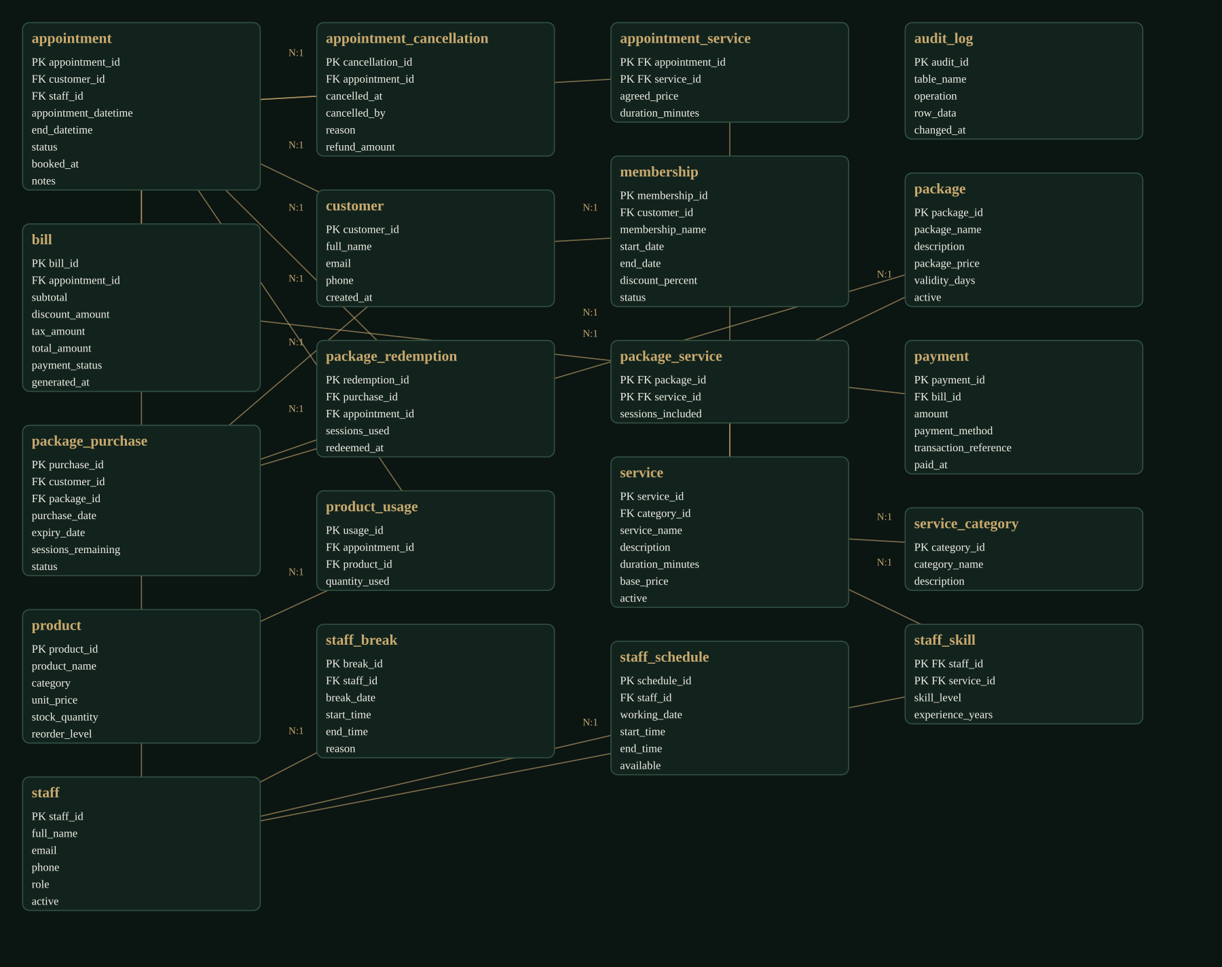
ER diagram
Generated from live PostgreSQL metadata: 20 entities, 21 foreign-key relationships
Core: customer, staff, service, appointment
Bridge tables: appointment_service, staff_skill, package_service
Billing: bill, payment, package_purchase, package_redemption
Support: staff_schedule, staff_break, product_usage, appointment_cancellation, audit_log

Slide 4
Normalization: UNF to 3NF
Example: one appointment with several services
UNF
1NF
2NF
3NF
One row per appointment; services and prices stored as comma lists
Atomic values: one row per appointment-service
Remove partial dependencies: customer and service data move to their own tables
Remove transitive dependency appointment → customer_id → name; keep only foreign keys
FDs: customer_id → full_name, email, phone · email → customer_id · (appointment_id, service_id) → agreed_price, duration. Price is a deliberate snapshot of the agreed price.

Slide 5
Business rules enforced by the database
Rule | Mechanism
No overlapping staff bookings; cancelled slots free | EXCLUDE (gist, tsrange) WHERE status <> cancelled
Not in past, inside schedule, valid status flow | trigger trg_appt_validate
Staff must have the skill; no booking in breaks | triggers trg_appt_skill, trg_appt_break
Stock never negative | CHECK + trigger trg_usage_stock
Package sessions cannot be over-redeemed | trigger trg_redeem (row lock)
Payment cannot exceed balance | trigger trg_payment_check
Atomic booking | Flask transaction, ROLLBACK on error

Slide 6
What works (tested on PostgreSQL 16)
Booking: customer → services → qualified staff → free slot → confirmation, saved in one transaction
Conflicting booking rejected by the database (HTTP 409); cancellation makes the slot bookable again
Billing with membership discount and 18% tax; payments are simulated, no gateway
14 reports and 13 SQL Lab queries run against live data
Database Explorer, Source Explorer (whitelist), ER diagram, Solution page, live SQL log
CRUD for customers, services, staff, skills and schedules; role views for customer, staff and admin

Slide 7
Testing, limitations and viva demo
Testing
Python unittest on an isolated database: 17 tests, all OK at the last run
Covers rules, rollback, billing, packages, stock, reports, CRUD, source whitelist
7-step demo
1. Register a customer
2. Book an appointment
3. Inspect the row in Database
4. Attempt a conflicting booking
5. Cancel and show slot release
6. Run a JOIN / revenue query in SQL Lab
7. Explain schema, normalization, triggers
Limitations
Role selector is not authentication
Payments simulated
Browser UI not yet tested in a real browser
Not run on Supabase yet

